Slide 1

UBS Challenge
Group 16:
Winson Luk
Andy Kwok

Slide 2
How we do our classification
Using Libraries: JieBa, SkLearn
Method:
1. Using JieBa to cut Chinese wordings from texts in raw tweets into different groups of words. Remove stopwords and calculate their it-idf scores in respect to different posts with labels (comparing to 1229 posts in total with labels)
2. Make 13 arrays with related words and their tf-idf scores (Based on 13 categories). Add 13 features for each sample with sum of counts with weighting. Sum of counts with weighting in Cat 0 = Number of times Word A occur in Post X (Belongs to Cat 0)* Relative tf-idf score + Number of times Word B occur…
3. We add more weighting of counts on words in hashtag (#XYZ#)
4. Use Logistic Regression for Training with cross-validations
Classification Recommendation Business Application Data Visualization Application of Tools
1

Slide 3
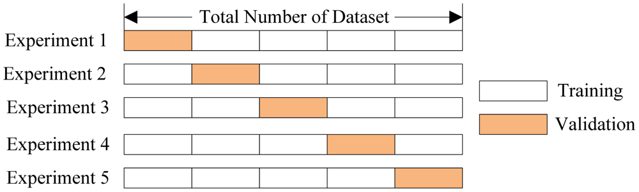
K-Fold Validation + Stratified Sampling
We did K-Fold Validation and set K = 10
Enhance Accuracy and Cover all Samples for training and testing
Category 2 has 11 while Category 3 only has 10 training set with labels!!!
Stratified Sampling ensure balance of classes in testing and training set
Classification Recommendation Business Application Data Visualization Application of Tools
2

Slide 4
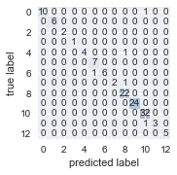
Result for Classification (Part (a))
Repeat 10 Times!
Then use the model giving highest F-score to make prediction!
F-score: 0.961240310
0.9140625
training fold 2 of 10
training fold 1 of 10
Classification Recommendation Business Application Data Visualization Application of Tools
3

Slide 5
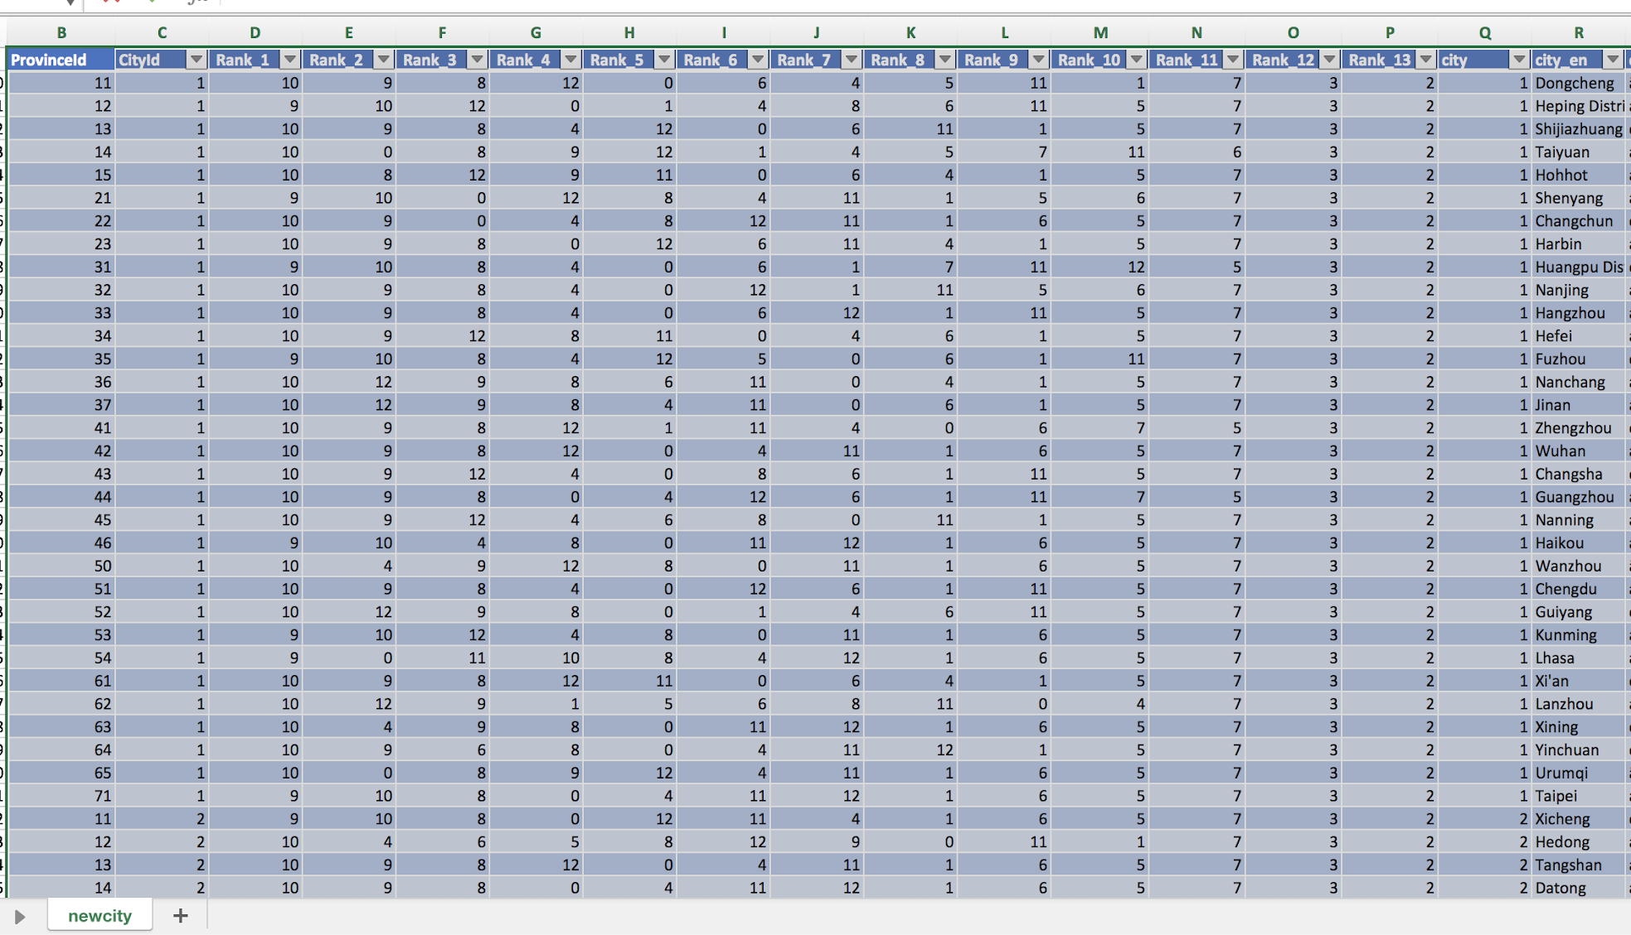
Our Recommendation with specific cities
The number Under Rankings are the number of Category of interests!
Based on number of counts of comments from different cities to different posts with their respective categories
Classification Recommendation Business Application Data Visualization Application of Tools
4

Slide 6
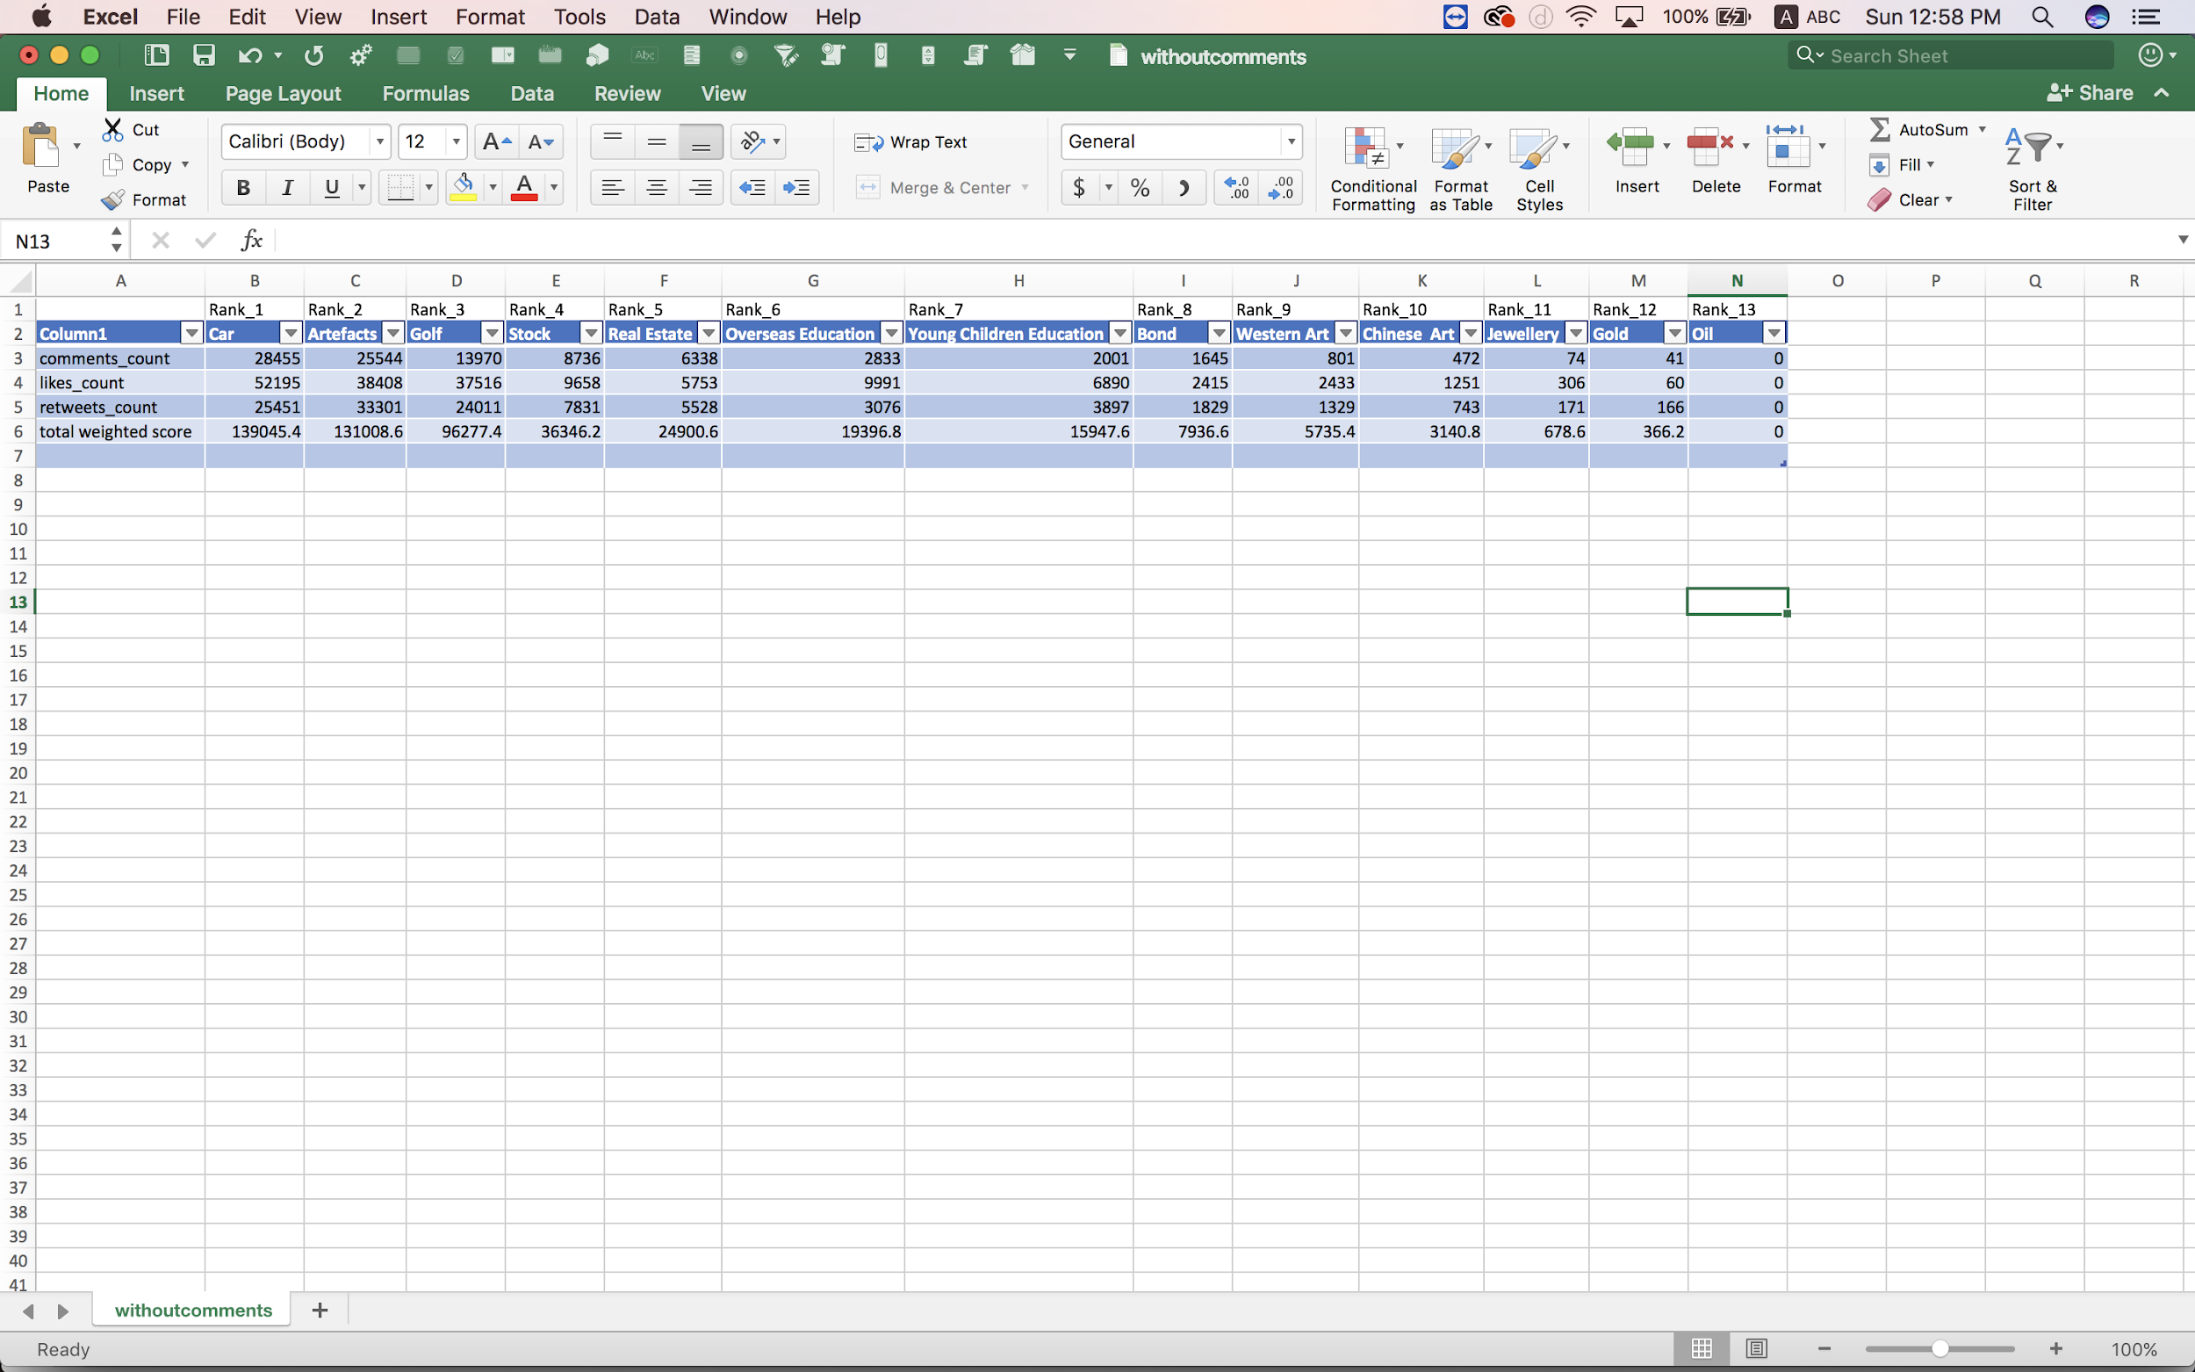
General Recommendations
Total weighted score = comments counts * 1.8 + retweets counts * 1.4 + like counts
Classification Recommendation Business Application Data Visualization Application of Tools
5

Slide 7
Business Value
Purchase intent can be lifted by 5.2 times when the users are exposed to brand and influencer materials[1]
Target Marketing can help the sales volume, e.g. Stock market
Can compare the interests against the actual sales value
Can deliver the content that interests the users as quickly as possible
Classification Recommendation Business Application Data Visualization Application of Tools
6

Slide 8
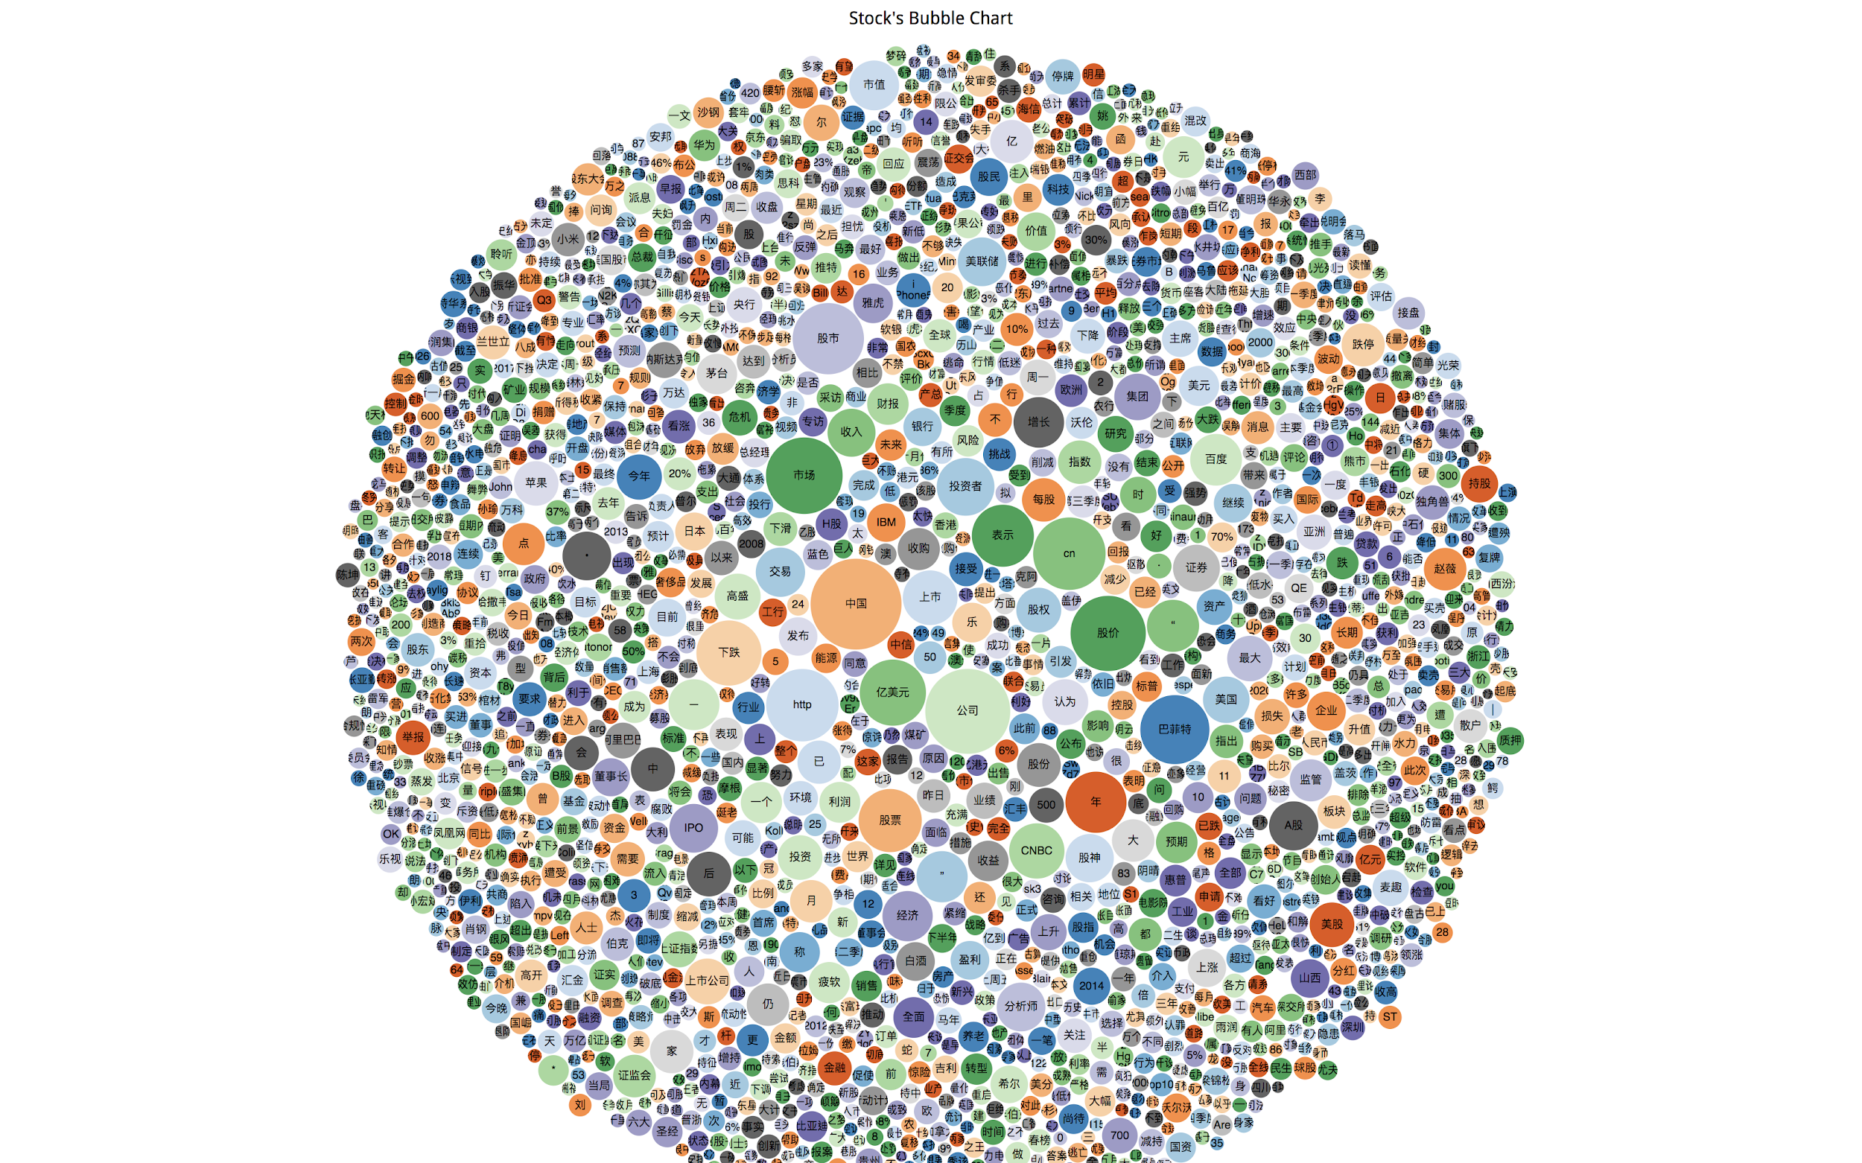
Impressive Classification Performance
Category: Stock
Frequent Words:
股价
市场
巴菲特
下跌
亿美元
Classification Recommendation Business Application Data Visualization Application of Tools
7

Slide 9
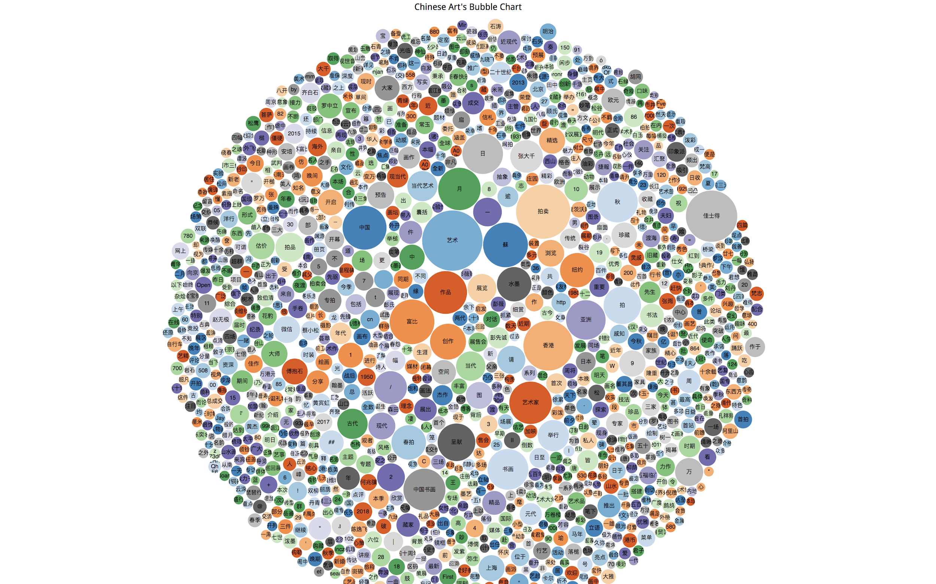
Impressive Classification Performance(2)
Category: Chinese Art
Frequent Words:
艺术
拍卖
创作
作品
艺术家
Classification Recommendation Business Application Data Visualization Application of Tools
8

Slide 10
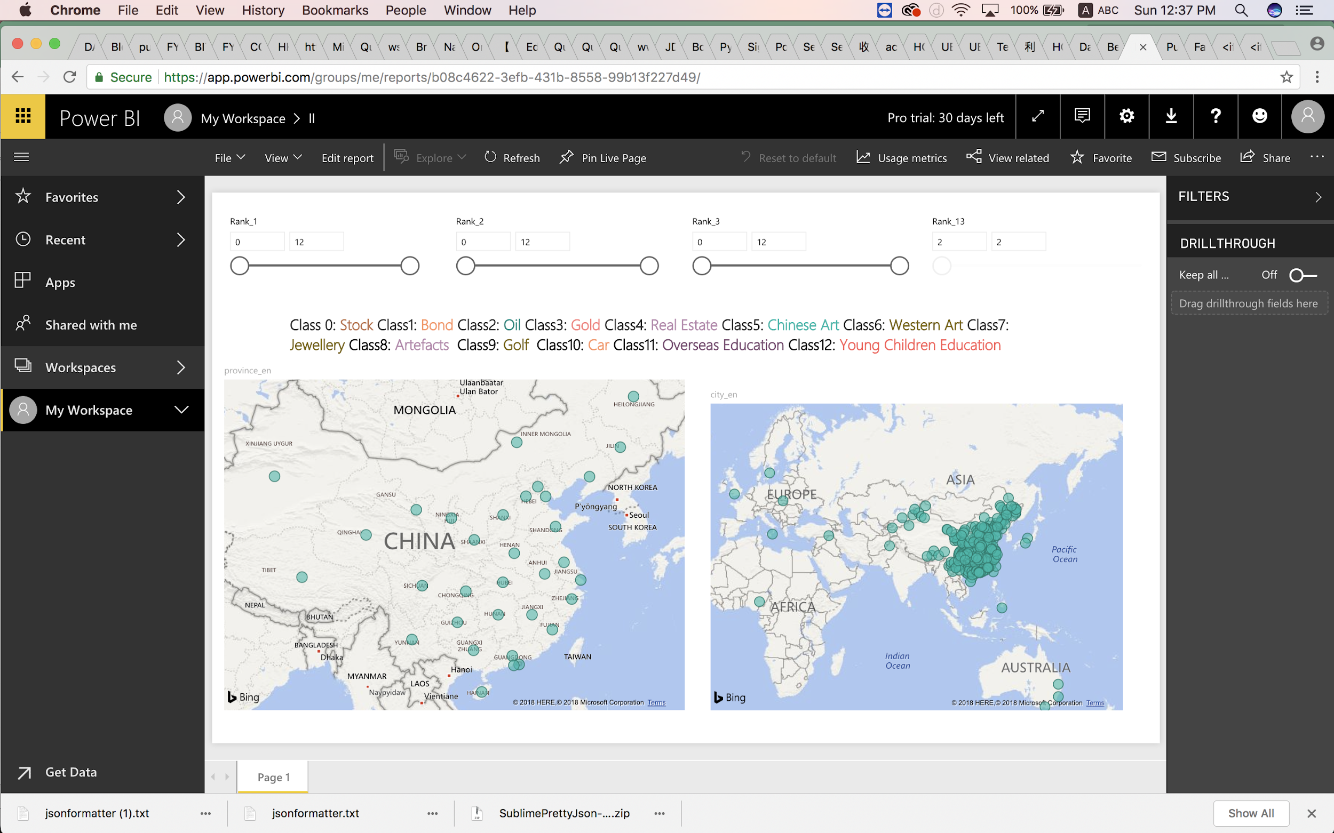
Application with PowerBI
To Provide Clear Insights from Maps to users about Hot topics in different cities
Classification Recommendation Business Application Data Visualization Application of Tools
9

Slide 11
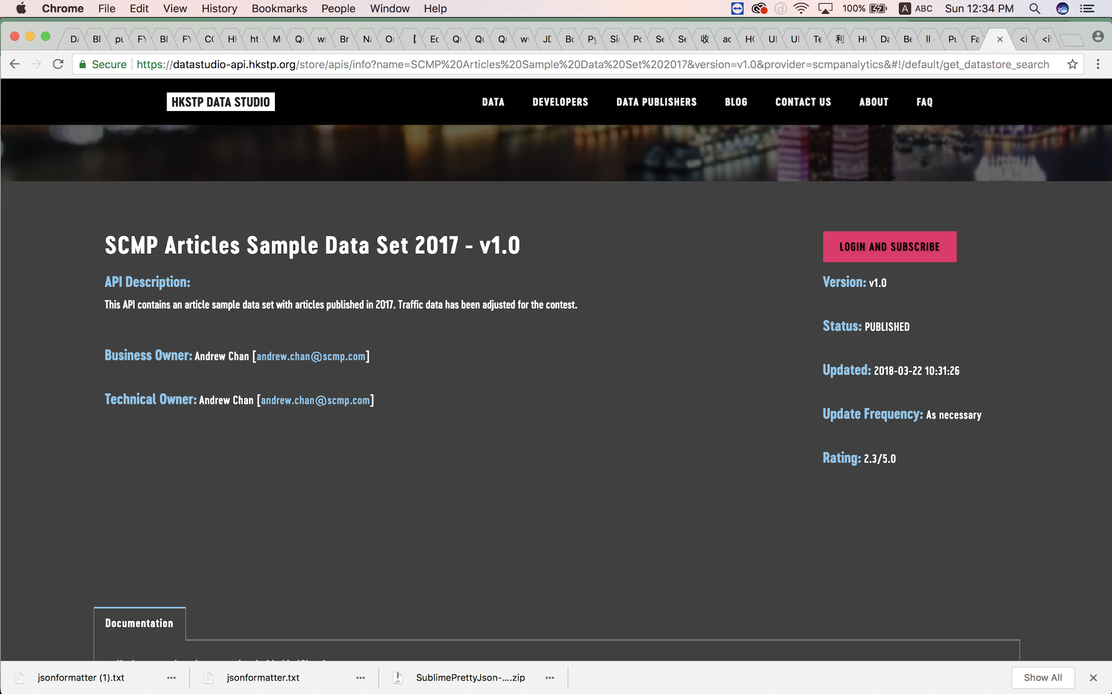
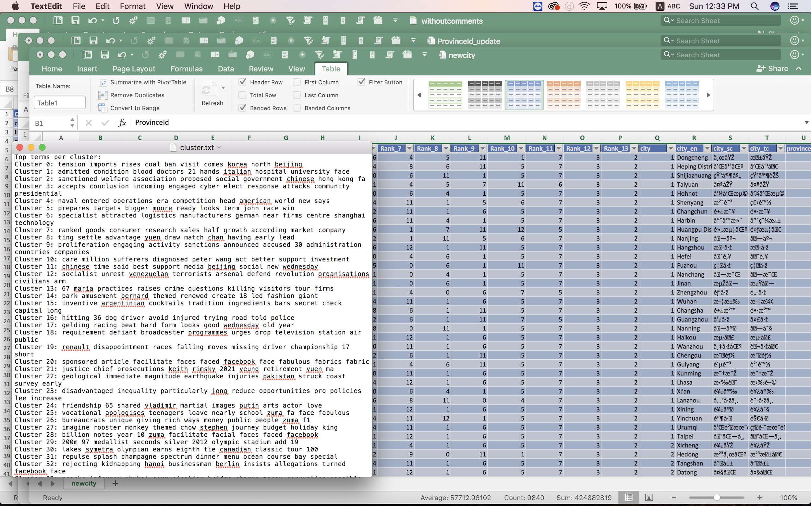
Application with Data Studio
Using SCMP News to do Clustering, and compare hot words in Hong Kong with WeiBo
Classification Recommendation Business Application Data Visualization Application of Tools
10

Slide 12





Library & Software
Jieba
Classification Recommendation Business Application Data Visualization Application of Tools
11

Slide 13
Q & A
Conclusion
12

